Slide 1
FitTrack
Fitness Simplified

Slide 2
Overview
Ever find yourself wondering if you've hit your fitness goals for the week or if that extra slice of pizza is going to set you back?
FitTrack is here to simplify your fitness journey.
This user-friendly app helps you effortlessly track your workouts and calorie intake, empowering you to achieve your fitness goals without the guesswork.
Whether you're a fitness enthusiast or just starting out, FitTrack provides the tools and motivation you need to stay on track and see real progress.

Slide 3
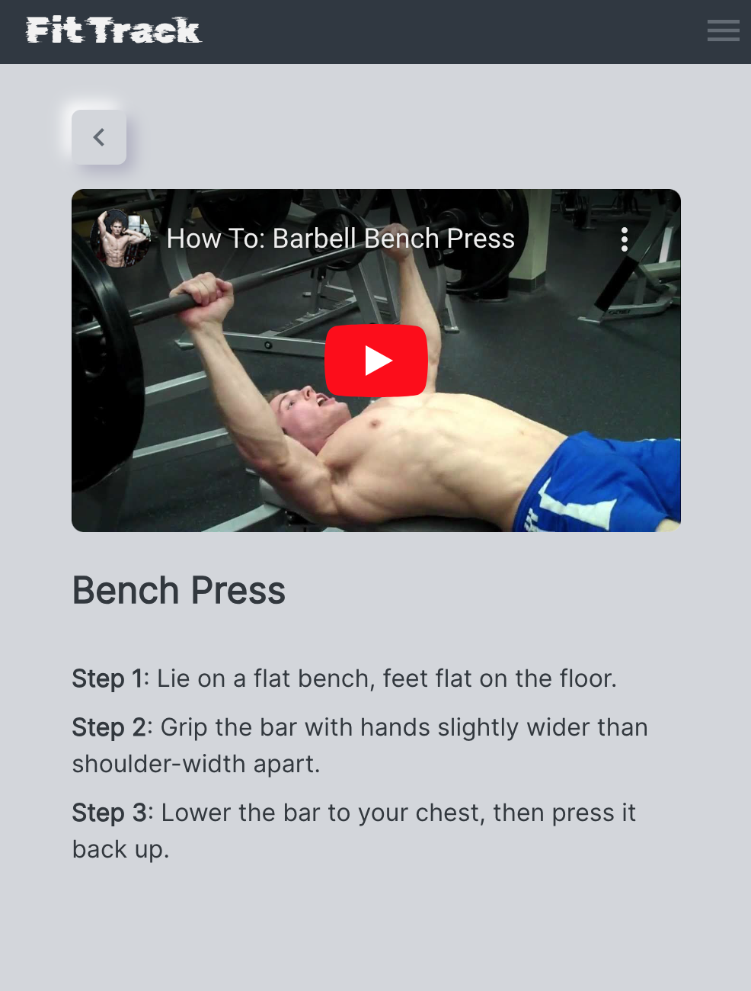
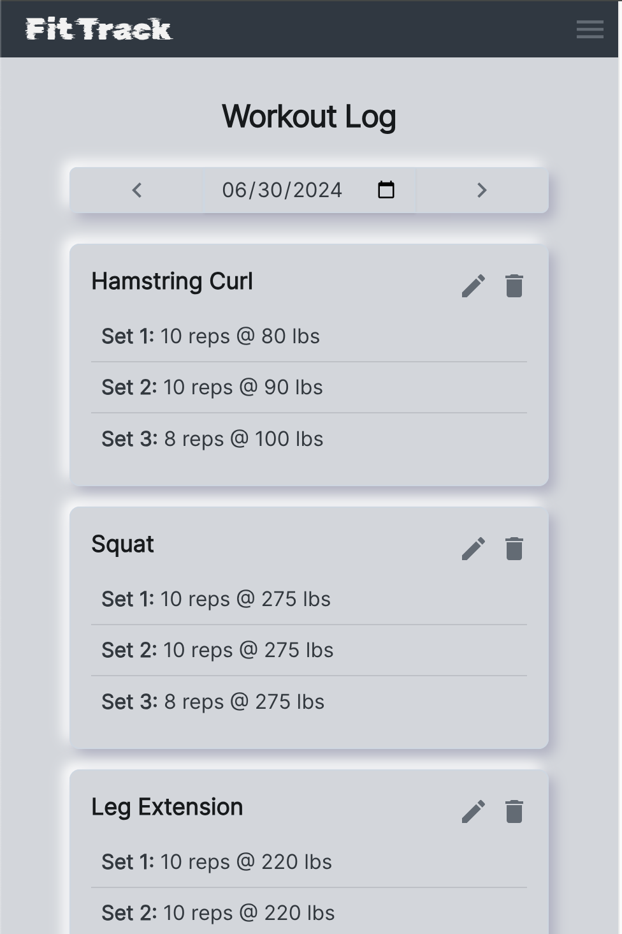
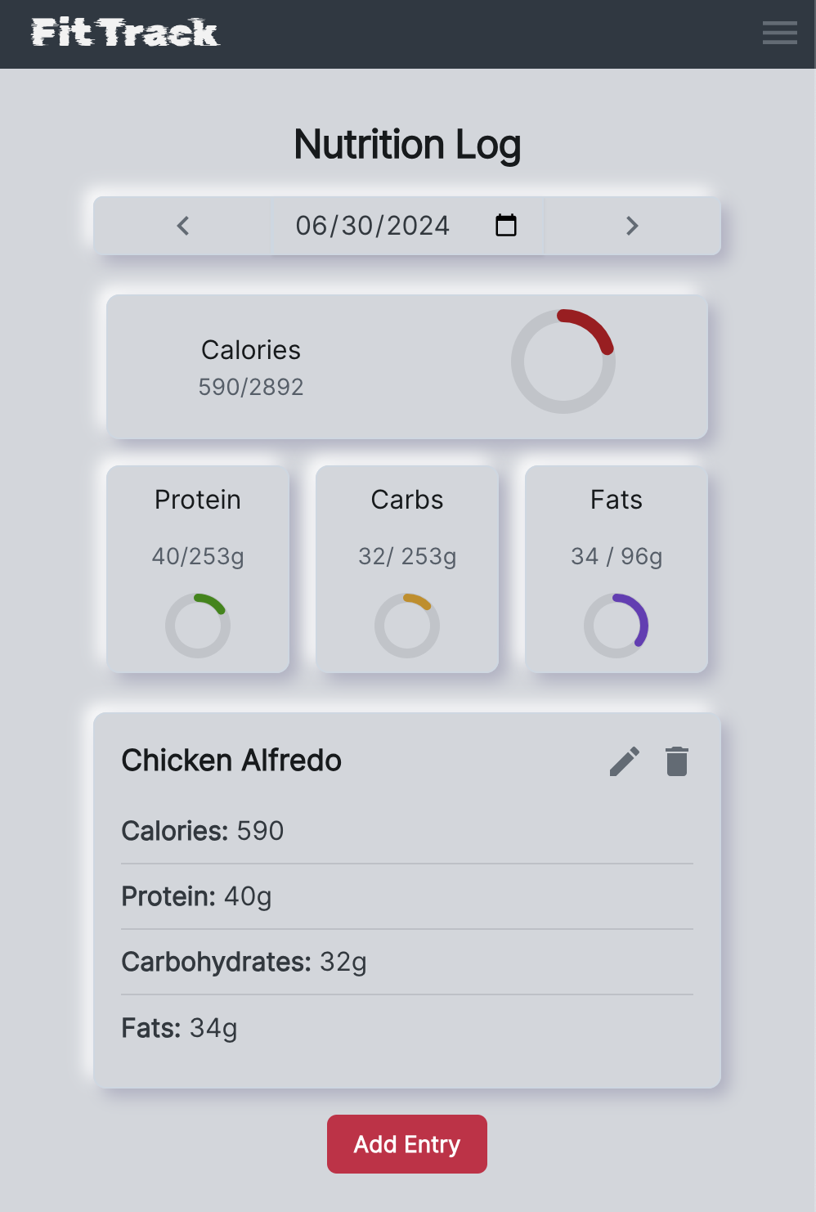
Overview
Extensive Exercise Library
View step by step tutorials to gain insight on proper form and technique
Workout Tracking
Log your exercises with ease
Calorie Intake Logging
Easily record your daily meals and snacks
(Food database coming soon!)

Slide 4

Demo

Slide 5




Questions?
www.linkedin.com/in/logan-weigel
https://github.com/W1gglez
weigelog@gmail.com

Slide 6
Technologies
Node
Express
React
Postgresql
Moment
Redux
Passport.js
Material UI
Fly.io
Neon.tech

Slide 7
Harrison Benedict Formula
Base BMR:
Male: 66 + (6.23 x your weight in pounds) + (12.7 x height in inches) – (6.8 x age)
Female: 655 + (4.35 x your weight in pounds x 1.20) + (4.7 x height in inches) – (4.7 x age)
Activity Level Multiplier
Little/no exercise: BMR * 1.2 = Total Calorie Need
Light exercise: BMR * 1.375 = Total Calorie Need
Moderate exercise (3-5 days/wk): BMR * 1.55 = Total Calorie Need
Very active (6-7 days/wk): BMR * 1.725 = Total Calorie Need
Extra active (very active & physical job): BMR * 1.9 = Total Calorie Need
https://www.mealpro.net/blog/what-is-the-bmr-calculator/
https://www.mealpro.net/blog/what-is-the-harris-benedict-equation/

